Slide 1

WISCONSIN FARM TO SCHOOL
Linking the Land with
the Lunchroom
Notes:
Add appropriate contact information for meetings or presentations.

Slide 2

Wisconsin Farm to School (F2S)
Farm to school encourages healthy lifestyles in children and helps support local economies. In Wisconsin, farm to school programs connect schools with locally and regionally grown and produced products.
In 2011, 72 WI schools and/or districts actively engaged with F2S !
Notes:
Take the opportunity to discuss your project mission.

Slide 3
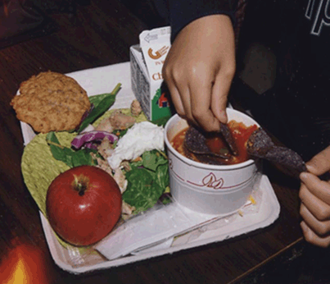
Goals of Wisconsin Farm to School
Promote children’s health by providing fresh, and minimally processed foods in schools to support the development of healthy eating habits
Madison
Notes:
Be sure to include one or more slides on your local project or goals.
Picture example:
Local whole products and ingredients accompany commodity items in new recipes developed in Madison for special meals. A veggie wrap with chicken provides the opportunity for seasonal grated vegetables to be incorporated as they become available.

Slide 4
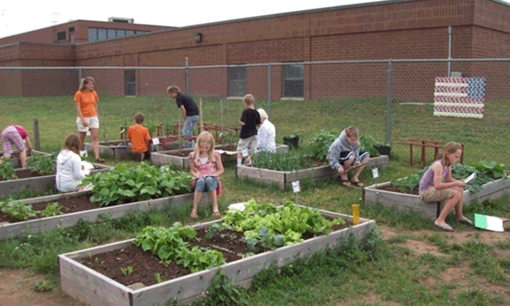
Goals of Wisconsin Farm to School
Strengthen children’s and communities’ knowledge about and attitudes toward agriculture, food, nutrition and the environment
Spooner
Notes:
There are many ways for farm to school to achieve this goal – and programs can be tailored to fit your school’s needs.
One example is pictured here:
School gardening has become an educational movement in and of itself, but is often found in conjunction with farm to school programs. The trend to incorporate environmental education and concepts of stewardship and food production go hand-in-hand with farm to school educational goals. The educational benefits of the teaching garden are vast and many schools are making gardens a priority, even during times of economic constraints.
Community partner organizations, volunteers, parents and local businesses can all become part of the support network for establishing and maintaining school gardens.

Slide 5
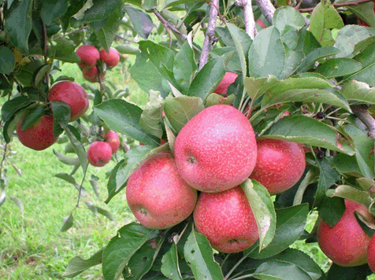
Goals of Wisconsin Farm to School
Strengthen local economies by expanding markets for Wisconsin’s agricultural producers and food entrepreneurs
Notes:
One example pictured:
Wiscomsin orchards are discovering schools as excellent markets, sometimes offering smaller apples perfect for children but not suitable for other markets. This opens up a new market for orchards and makes use of produce that might be hard to sell otherwise.

Slide 6
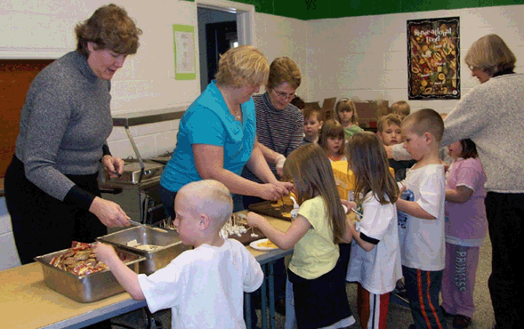
Farm to School Values
An individual’s lifelong well‐being depends on healthy eating habits
Wauzeka
Notes:
Spending time as a group discussing mutual goals and values for your farm to school program at the beginning will help create a smooth transition to good decision making down the road.
Through repeated exposure and lots of taste testing, children can develop the habit of trying new fruits and vegetables, and the healthy habit of eating more fruits and vegetables that can last a lifetime.
Picture example:
Schools participating in the USDA Fresh Fruit and Vegetable Snack program can utilize these funds to increase local, seasonal purchases of fresh produce. Children benefit from the exposure to new items they may not have been familiar with before, but can learn to love with repeated tasting opportunities.

Slide 7
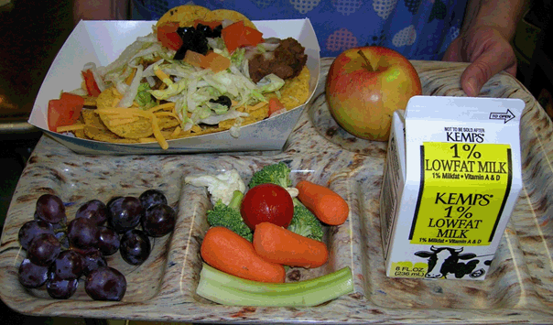
Farm to School Values
Children should have access to fresh, healthy and minimally processed food as part of a nutritionally balanced school meals program
Chilton
Notes:
Picture Example:
Local and regular menu items can make for colorful meals with lots of nutrition for students. This lunch tray from Chilton, Wisconsin features minimally to no processed sides – which encourage children to eat fresh, raw fruits and vegetables. The entrée features locally raised, grass-fed beef and lots of veggies, making a fun meal that kids enjoy while being very nutritious.

Slide 8
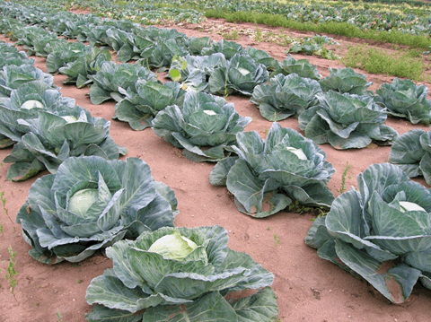
Farm to School Values
Wisconsin farms that serve local markets make essential contributions to a diverse food system
Notes:
Local farms can be small-scale or large scale producers.

Slide 9
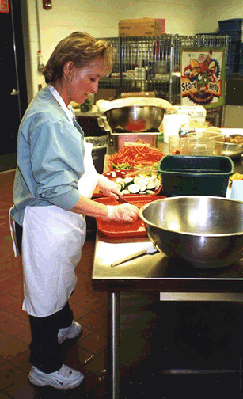
Farm to School Values
Schools and nutrition professionals are important partners in supporting community well-being, local economies and environmental stewardship through their food and nutrition education programs and purchasing practices
Whitewater

Slide 10
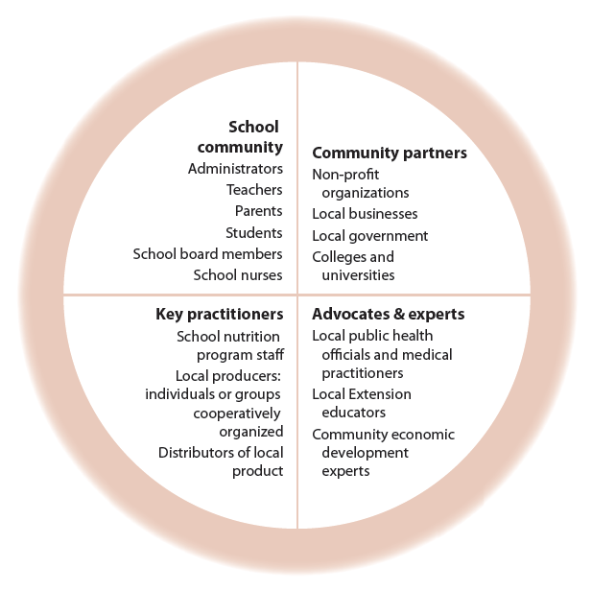
Community support for farm to school

Slide 11

Farm to School in Wisconsin
Local, farm-fresh foods can be purchased:
Directly from farmers
From a farmers’ market
From a growers’ collaborative or cooperative
Through a distributor or broker who procures from local farmers
Notes:
Wisconsin farm to school programs are growing at a variety of scales and are sourcing from a variety of outlets.

Slide 12
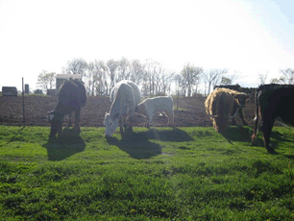
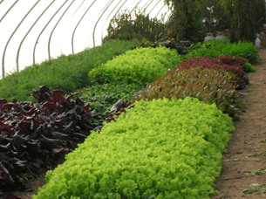
Types of Farms Working with Wisconsin Schools
  Orchards
  Dairy and meat producers
  Produce: Small, medium and large growers
Notes:
Wisconsin orchards are discovering schools as excellent markets, sometimes offering smaller apples perfect for children but not suitable for other markets at a lower cost. Wisconsin apples are becoming more available to schools through direct purchasing and/or regional distributors.
Direct connections with livestock producers willing to process products to school specifications are becoming more popular. Food safety issues do not have to be prohibitive. Fresh and frozen meats are allowed to be used in school lunch programs with standard HACCP plans for working with these products. Meats can be used all year round and highlighted during the months when local produce is less available. A variety of local dairy products can be found successfully in Wisconsin, as well.
Small, intensive market gardeners and growers may be the perfect scale for some smaller school districts. Many of these growers, committed to local markets, are working with season extension, such as this hoophouse garden producing fresh greens throughout the fall, and sometimes winter and early spring. Hydroponics and storage crops are another way farmers are extending the season for their clients in the northern clime of Wisconsin and elsewhere around the country.
Larger Wisconsin producers may be a better fit for larger districts. Some will still work directly with food service, or may have their products available through regional produce distributors.

Slide 13
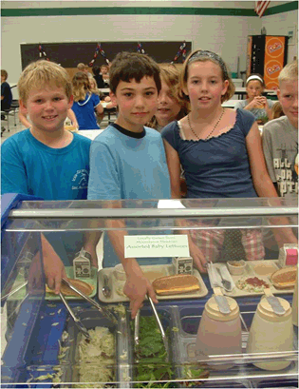
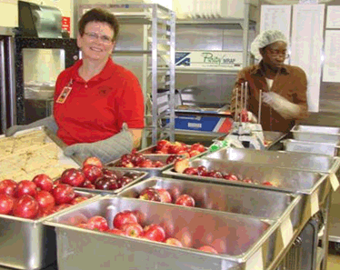
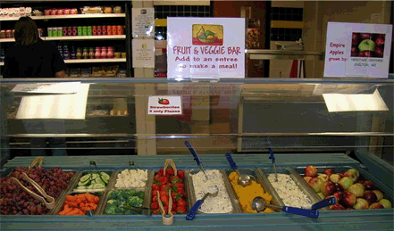
Using Local Products
in School Programs
Waupaca County
Whole items
Salad or fruit/veggie bars
Chilton
New Richmond
Notes:
Picture examples:
New Richmond - Apples are a good example of incorporating a whole item not requiring processing. Many Wisconsin schools start farm to school efforts with locating a local orchard and purchasing directly, or buying Wisconsin apples through their regional produce distributor. Some orchards will sell smaller apples not appropriate for their regular markets to schools at a lower cost. The smaller size can be perfect for school children!
Waupaca County - Salad bars allow menu flexibility. “Seasonal vegetables” can be stated on menus, allowing whatever is available and fresh to be served. Salad bars are also popular with students, allow free choice and expose children to a wide variety of fresh vegetables. Many children will choose salad bars as part of their everyday lunch experience, if available.
Chilton - Daily fruit and veggie bars are also becoming popular with students and nutrition directors as a flexible way to incorporate a wide variety of local produce, in season, and when the price is affordable. Students learn to “eat with their eyes” for a variety of color and appropriate portion sizes.

Slide 14
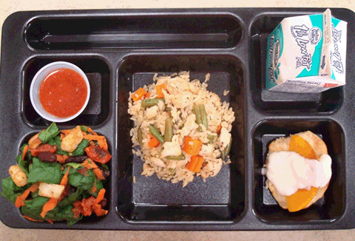
Using Local Products in School Programs
Substitute item or ingredient already used
Develop new recipes and menus to include local products
Viroqua
Notes:
Picture example:
Menu development may be a creative, fun and educational way to incorporate local foods. The recipes were developed by students to meet the national school lunch program nutritional guidelines, utilize local and commodity foods, and meet budget requirements per meal. The menu shown on this tray won these Wisconsin high school students entry into a national health school lunch contest!

Slide 15
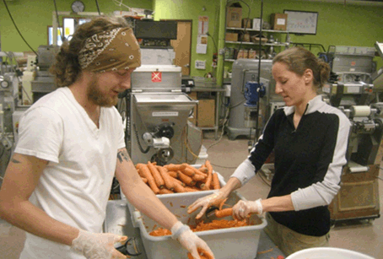
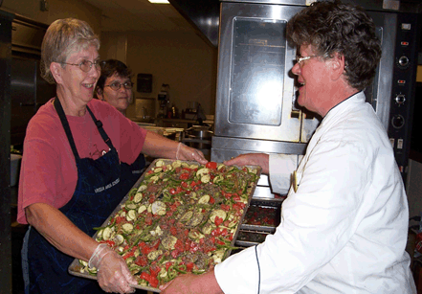
Using Local Products in School Programs
Snack programs
Freezing seasonal items for year round use
Madison
Viroqua
Notes:
Picture Examples:
Madison - Snack programs are also becoming popular as a way to offer students increased access to local and fresh fruits and vegetables. Volunteer labor is often used in off site, community partner kitchens to process the snacks in a ready-to-eat form.
Viroqua - Some Wisconsin schools are capturing the harvest season (August/September) when most produce is available and costs less. By processing and freezing items in the summer and fall, nutritious and local foods can be on the menu all year round. Because the produce is getting processed, schools do not require #1 produce and can often purchase #2 or #3 grade produce at a lower cost. Quality is still as high; size, shape or “blemishes” may be the only issues. In this photo, a colorful tray of ratatouille is shown before freezing. It is then offered to students throughout the year as pizza topping and in pasta, soups, stews, wraps and as a side dish.

Slide 16
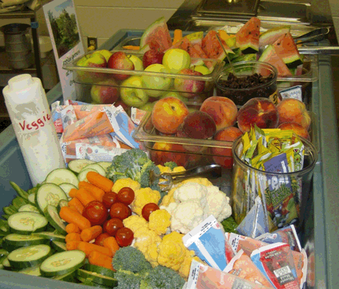
School Food Service
Challenges and Opportunities
Delivery
Food safety
Price
Time
Finding Local Producers
Seasonality
Scale/reliable supply
Labor/food prep
Staff skills
Storage/refrigeration
Student preferences
Chilton
Notes:
The challenges shown in bold type may or may not present themselves as the greatest challenges. This will vary from school to school. Some barriers may be only perceived as issues and overcome more easily and others will present issues requiring creativity and additional support or information in order to address successfully.
Picture example:
The balance of whole items and produce needing minimal processing, at affordable prices, is the challenge school food service faces in order to provide students a choice of colorful and nutritious fruits and vegetables as a regular part of their diet.
Local produce can be more labor intensive in the school kitchen, but once systems are in place, many schools find it possible to incorporate more fresh fruits and vegetables.

Slide 17
Producer
Challenges and Opportunities
      Price point
      Food safety/liability insurance
      Delivery
      Scale
      Time
      Meeting packing specs
      Seasonality
      Storage/refrigeration
      Quantity
Notes:
Challenges for farmers are similar to those for food service, but the other side of the coin. Farmers and food service professionals learning about each others’ needs and realities is part of building successful working relationship. It requires plenty of clear communication and the building of a strong partnership over time. Trial and error may be part of the road to creative solutions and an ongoing, successful and growing program.

Slide 18
Challenges and Opportunities
Although challenges exist, there are tools and resources available to address them. Tools and resources for schools and producers can be found at:
UW Center for Integrated Agricultural Systems–
  http://www.cias.wisc.edu/toolkits/
Notes:
Orchards Interested in Selling to Schools –
www.reapfoodgroup.org/Farm-to-School/homegrown-lunch-resources.html
The food service resource page on REAP’s Farm to School website has a map and information about Wisconsin orchards interested in selling to schools. This list is growing.
Institutional Food Market Coalition – The IFM Coalition at www.ifmwi.org/produce.aspx
provides links to producers, producer groups, and distributors providing locally sourced produce, meat, dairy and other foods specifically to institutions.
Farm Fresh Atlases –
Many regions in Wisconsin have created atlases listing farms and farmers markets in their areas.
Go to www.farmfreshatlas.org/ to find an atlas for your region.
University of WI Cooperative Extension –
Find your county extension office at www.uwex.edu/ces/cty/ or call your regional office (#s below). They may know how best to reach area farms or be able to connect you to farm market managers. Southern: 608-263-2781 (Madison) Eastern: 920-465-2147 (Green Bay)
Central: 715-346-2760 (Stevens Point) Western: 715-743-5420 (Neillsville)
Northern: 715-635-9190 (Spooner)
Savor Wisconsin –
A listing of Wisconsin producers and farmers markets in Wisconsin is at www.savorwisconsin.com. Includes search options by region, county, producer, product, and markets.
Local Harvest –
A state-by-state guide to buying locally at www.localharvest.org; includes a search for farms, markets and retail stores.

Slide 19
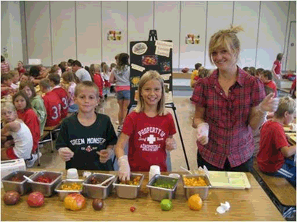

Educational Activities
Taste tests
Cooking demos
Mt. Horeb
Port Edwards
Notes:
Complimentary educational activities are a key component of any farm to school program in order to work toward the following farm to school goals:
Short term student familiarity and acceptance of new items introduced in the cafeteria or snack program
Long term impact on student healthy eating habits and food preferences.
Picture examples:
Mount Horeb - Cafeteria or classroom taste testings are a common and popular approach to engaging students in tasting new foods, increasing familiarity and establishing personal preferences. They are relatively easy to do and fun for participants. Recruiting volunteers or older students to help with tastings can be helpful and increase school community awareness of farm to school efforts.
Port Edwards - Cooking demos are popular to ensure that students are receiving hands-on education from seed to plate. Learning to cook is a core skill for lifelong healthy eating habits. Cooking demos often take place in the classroom, with a guest chef or dietician. Local honey and apples are a treat in this apple crisp-making demo.

Slide 20
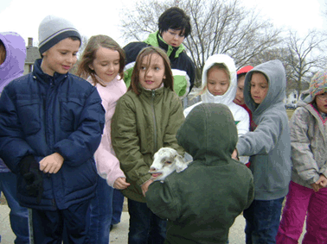
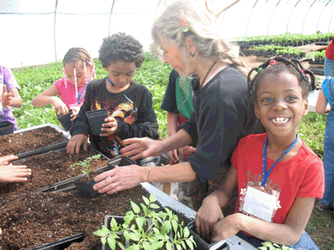
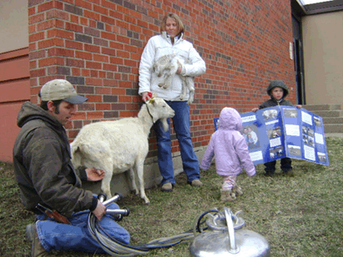
Educational Activities
Farm tours
Madison
Prairie Du Chien
Notes:
Picture Examples:
Madison - Farmer educators can be a central part of a farm to school program, both in the classroom and on the farm. Children learn through their senses and kinesthetically. Hands-on experiences are meaningful and memorable.
Prairie du Chien - Children benefit from exposure to the natural world as part of their education, including creating relationships with animals. It is important that students understand where their food comes from, including livestock for dairy and meat.

Slide 21
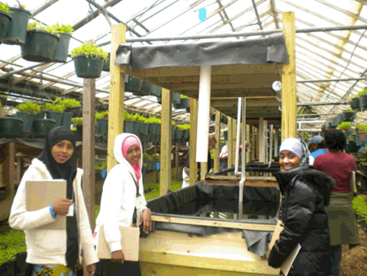
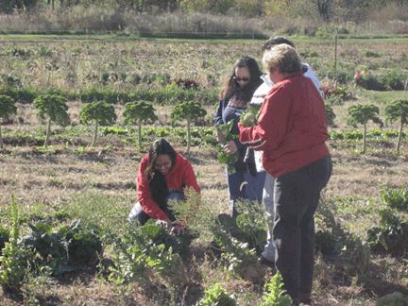
Educational Activities
Field Trips
Barron County
Monona Grove
Notes:
Field trips are a key to exposing students, firsthand, to food production in their communities and their state.
Picture examples:
Barron County – field trip for students.
Monona Grove - Farm field trips are not just for students! In this photo, food service staff are treated to their own field trip to a local farm that provides some of their produce. This activity is a wonderful way to give food service providers the opportunity to connect to the source of their food and gain a deeper understanding of, and investment in, farm to school goals and principles.

Slide 22
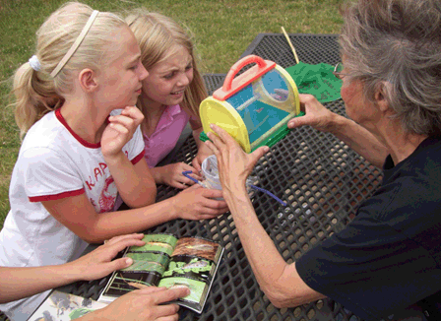
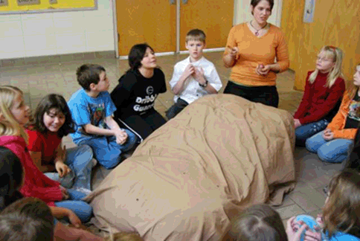
Educational Activities
Chef/farmer visits
Washburn
Spooner
Notes:
Classroom activities are common in farm to school programs. Sometimes lessons are delivered by teachers, other times by volunteers or special guests, such as farmers or chefs.
Picture examples:
Washburn - In this picture, an AmeriCorps member teaches a lesson on the Wisconsin potato, the Harvest of the Month local product.
Spooner - Experts such as Extension agents and master gardeners can help serve as special guest educators in the classroom, in the garden or on the farm.

Slide 23
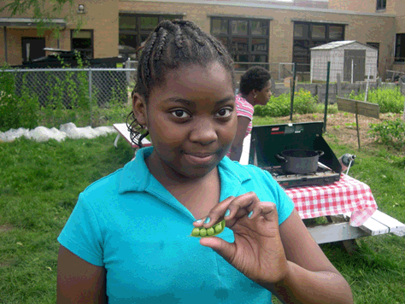
Educational Activities
School gardens
Greenhouses
Madison
Notes:
Picture example:
Madison - In this picture, a student is showing peas from a garden. She and other students received a cooking demo right in the garden, as close as possible to the source of the food they have produced themselves.

Slide 24

Educational Activities
Cooking contests
Composting/recycling
Viroqua
Notes:
Picture example:
Viroqua - Student healthy school lunch cooking contests have become a popular way to engage and educate students to the challenges and opportunities of their school lunch programs. These Wisconsin youth and a volunteer chef mentor won their way to a national contest in Detroit, Michigan in May 2010. Triple award winners of their local contest, these students are proud creators of menus that are now served in their own cafeteria for their fellow students.

Slide 25
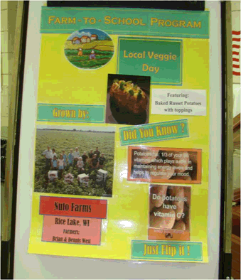
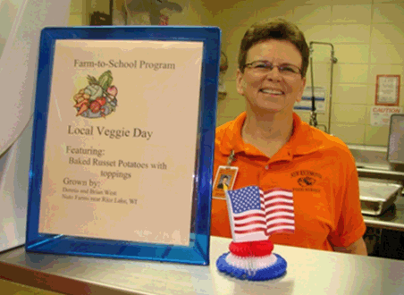
Educational Activities
Harvest of the month
CSA, farmers’ markets
Visual Displays
New Richmond
Notes:
Promoting farm to school activities and offerings right in the lunchroom, often at the point of service, is an important educational activity, so students and teachers are aware of which items are locally produced. Educational information such as nutritional content or local history can be highlighted, as well. If volunteers are involved, creating these materials is another useful role they can play.

Slide 26
WI Farm to School Program Support
UW Center for Integrated Agricultural Systems
http://www.cias.wisc.edu/toolkits/
http://www.cias.wisc.edu/category/farm-to-fork/farm-to-school/
Health in Practice
http://www.healthinpractice.org/obesity-prevention/farm-to-school
Make Farm to School Happen http://makefarm2schoolhappen.org/
Team Nutrition (DPI) http://fns.dpi.wi.gov/fns_f2s
AmeriCorps (DATCP)
http://datcp.wi.gov/Business/Buy_Local_Buy_Wisconsin/Farm_to_School_Program
National Farm to School Network http://www.farmtoschool.org/
USDA Farm to School Program http://www.fns.usda.gov/cnd/f2s/
Notes:
Contact information for resources and support for farm to school in Wisconsin.
Add a slide with contact information.

Slide 27


