Slide 1
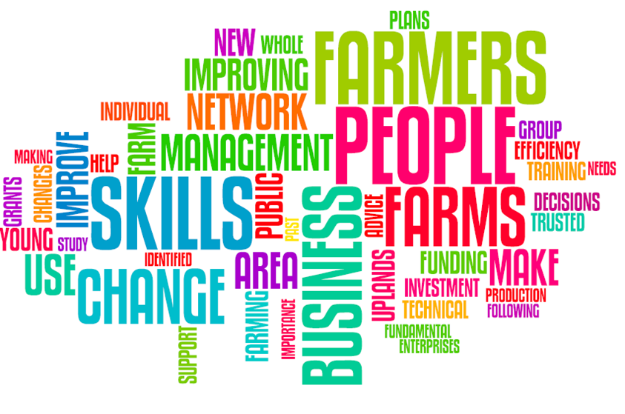

Slide 2
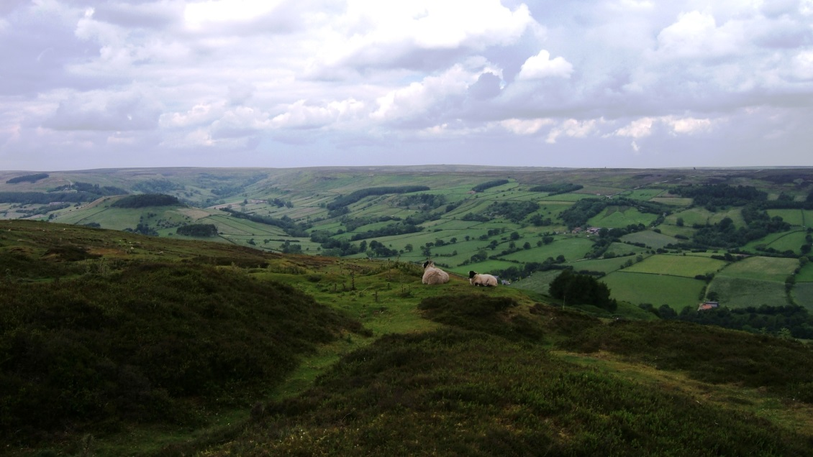






Dales and Moors Farm Innovation Project: Whole Farm Planning

Slide 3




Funded through:
Supported by:
Thank you!!

Slide 4
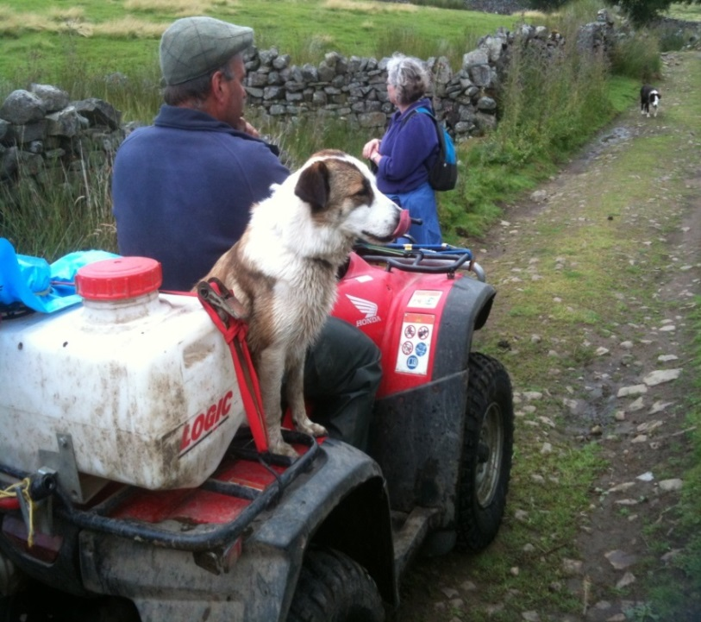
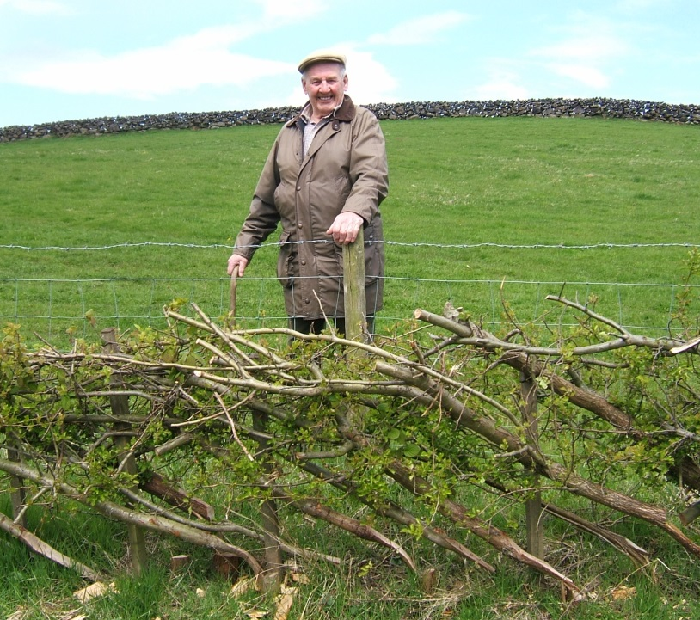
Presentation outline
The project plan and implementation
Summary of preliminary results and findings
Impact: what difference has the project
made to Yorkshire’s economy?
Disseminating the results

Slide 5
What the SEP Says
Core Activity 21: Sustainable growth in the Dales, Moors and Wolds
“We have an unmatched rural area covering the Yorkshire Dales National Park, North York Moors National Park, three AONB’s and the Yorkshire Wolds; an outstanding landscape.”
Improve the resource efficiency of ‘High Nature Value’ upland farming
Annex C – A Local Growth Plan for the Yorkshire Dales National Park; North York Moors National Park; Nidderdale Area of Outstanding Natural Beauty; and Howardian Hills Area of Outstanding Natural Beauty

Slide 6
Some Stats
Agriculture in the study area is of fundamental importance to the economy of the area, contributing around £328m to the local economy.
Farming makes a significant contribution to the rural economy of the area, with over £241m per year being spent by farmers on goods and services
Hill farming in the target area is under severe financial pressure with average profits of less than £20,000 per year, despite receiving average payment of over £47,000 per year from the public sector and this forecast to reduce over the next 5+ years.

Slide 7
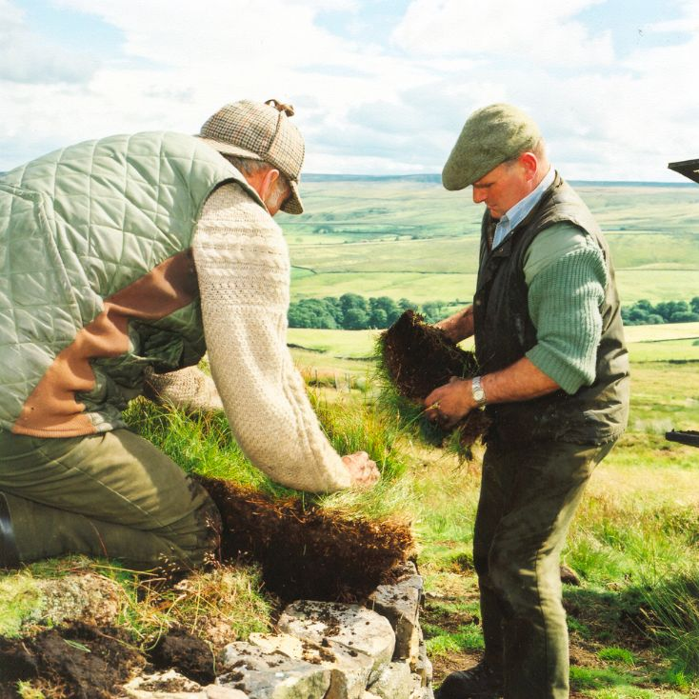
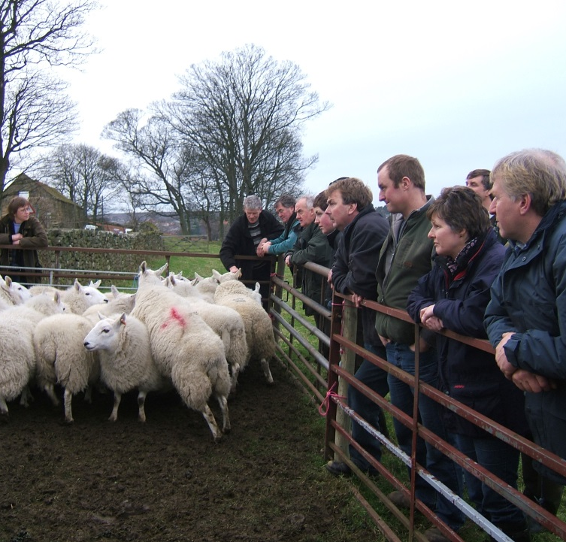
The project plan
Why upland farmers in the Dales and Moors are important
Project locations and partners:
Yorkshire Dales and North York Moors National Parks, Nidderdale and Howardian Hills AONBs plus Farmer Network and Newton Rigg College who co-ordinate and monitor the Project and award qualification certificates to participating farmers
Aim to improve business and environmental performance by facilitating 50 Whole Farm Plans with costed three year action plans
The project also identifies ‘skills gaps’ and how these might be addressed in the future e.g. farm accounts, EID training, online application process for grants etc
Notes:
Challenges that upland farmers face in the area (possibly to be put into a word cloud)
Resilience and benchmarking
High reliance on agri-environment income
Unprofitable livestock (Pure swaledale / suckler cows)
Limitations to renewable energy use (PV, AD, biofuel, wind)
High power and machinery costs above benchmark figures
Footpaths through farmyards
Lack of organic abattoir and processing
Increasing rents
Succession and support for young farmers
Support for diversification
Branding and marketing of local products
Broadband, mobile and IT issues
Innovation and infrastructure

Slide 8
Learning Outcomes
To seek and take advice from business and environmental advisors regarding own farm business
To analyse own farm business and identify future needs to improve profitability by the production of a whole farm plan
To identify future actions needed to improve the environment in which the farm operates
To identify any skills gaps and training requirements needed to meet identified actions

Slide 9
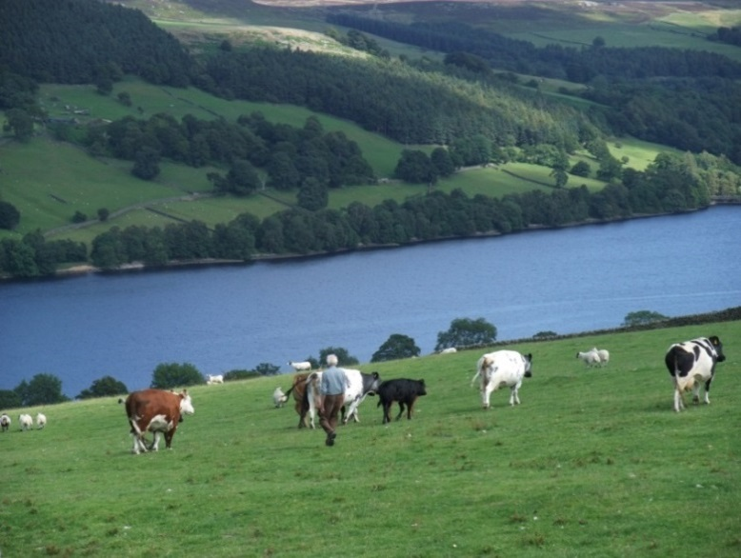
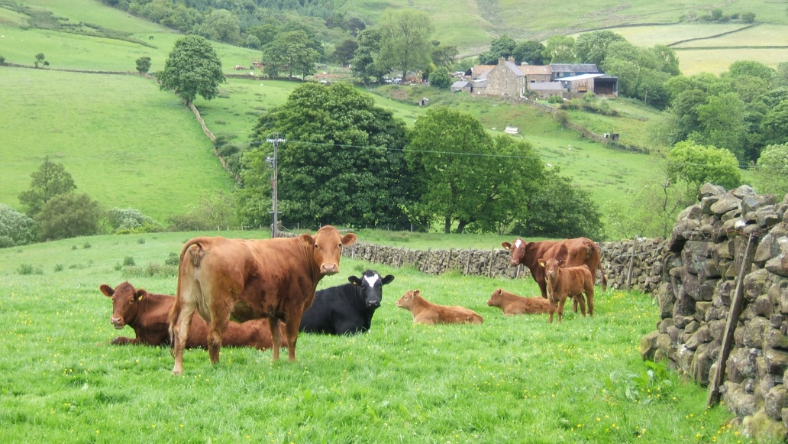
Research Outcomes
To summarise the business investment and training needs for uplands’ farmers including:
  skill gaps identified
  training demand predicted
  priority areas for diversification.

Slide 10
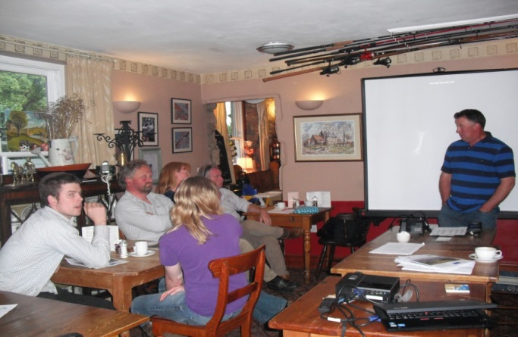
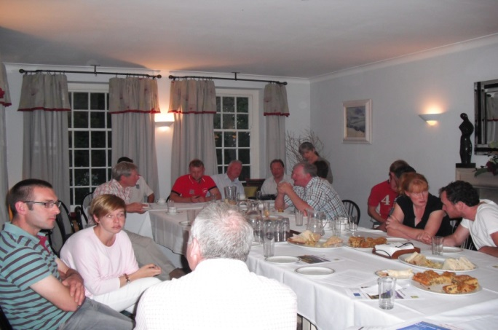
Key Outputs
50 Whole Farm Plans have been produced involving over 60 learners
One-to-one support from environmental and business advisers
Group meetings to share ideas during which common themes and feedback were given and issues were discussed between the farmers and advisers
Final report including recommendations for further interventions

Slide 11
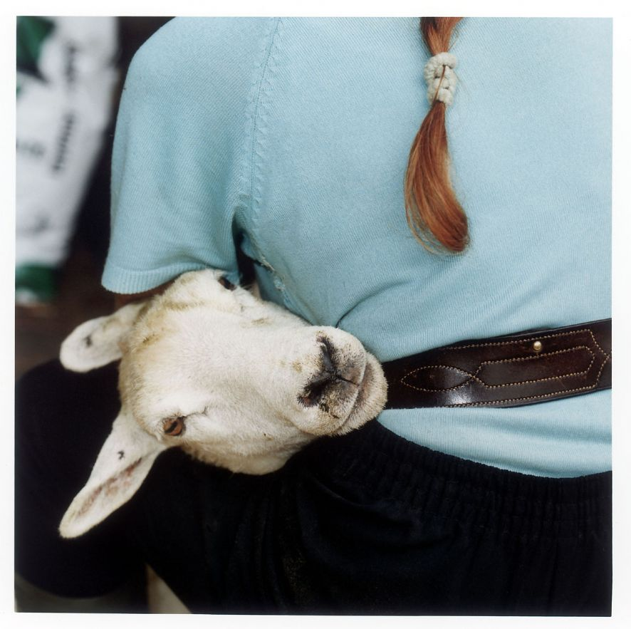
Preliminary results
Environmental appraisals show that the farms contain a high density of nationally and internationally important conservation assets.
Our farmers want to work with scientists and others to improve the productivity of their land and livestock and improve habitats for wildlife
They want to invest in buildings, infrastructure and new technology to improve efficiency and profitability
Diversification and new business ventures are on the agenda for many

Slide 12
Skills Gaps Identified
Financial management including management recording, understanding accounts
Business analysis and planning
Marketing
Improving IT skills – computer use, social media,
Technical knowledge – soil management, crop management for production and wildlife, new crop and animal husbandry developments
Technical training – safe use of pesticides, hedge laying, chainsaw use, ATV use, etc.

Slide 13
Key Barriers
Farmers lack of time to invest in making the changes needed
The traditional farming systems and a reluctance to change
A lack of the right skills
Need for advanced farming technical skills
Farmers need support but lack of trust for, feel isolated and let down by “Government” and are wary of outside help
Significant changes to agri-environment support packages
Small proportion would respond to formal training but most would not
Subtle approach needed to engage farmers using networks and trusted intermediaries to provide training and support to help them to become more open to change and provide the new skills they need, working with relevant experts when needed
Some capital investment on farms would help to stimulate engagement in training/knowledge exchange activity

Slide 14
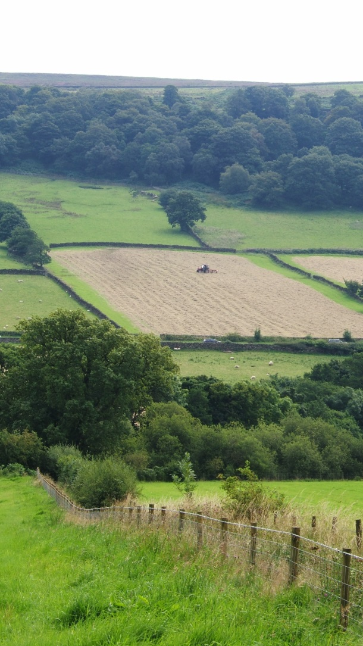
Preliminary findings
Excellent process to go through but needs continuation via farmers forum/network to maintain links with relevant organisations
Project generated lots of ‘learner’ registration paperwork!
Timing needs considering – relating to the farming year
Focused minds on future environmental and financial management of each farm
Brought out common themes
Gave an opportunity to have open discussion with experienced advisors
Produced a farm plan which can act as a catalyst for action and potential funding for projects in the future
A positive experience for all!

Slide 15
“Very useful – as it has given the region’s hill farmers the opportunity to look at other ways of doing things – and has been thought provoking for the next farming generation.”
Farmer involved in the Project

Slide 16
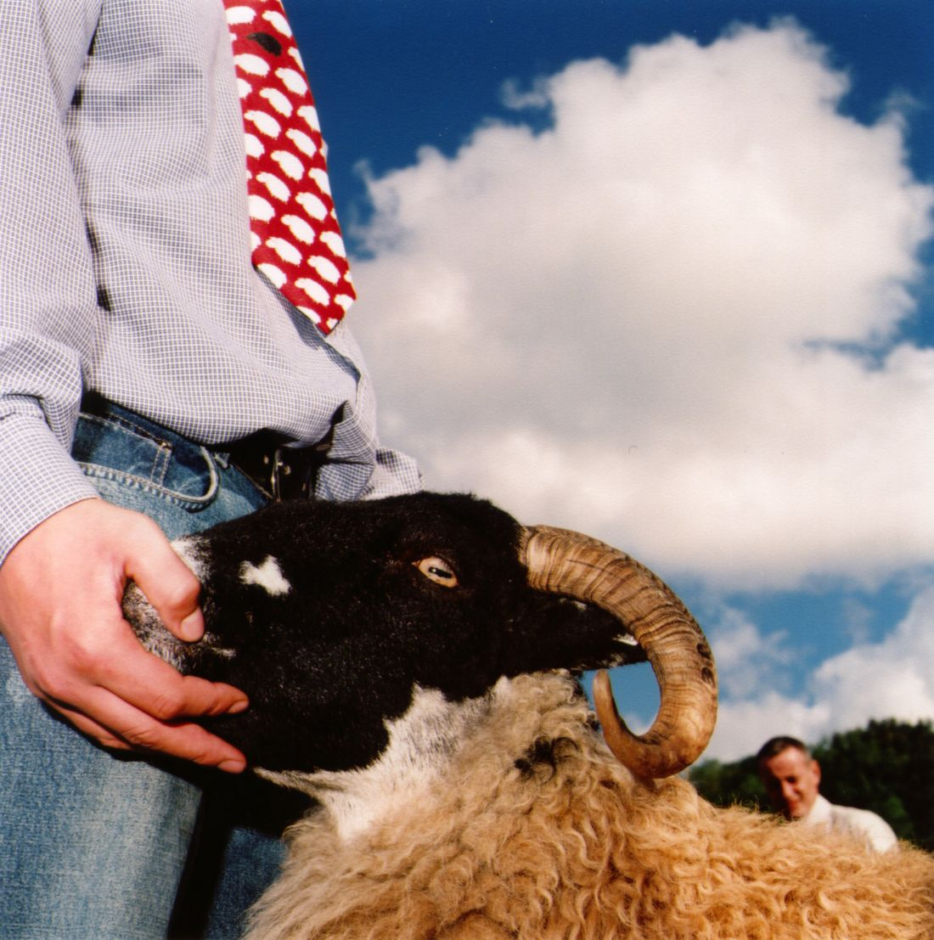
What difference has the project made to Yorkshire’s economy?
The work has demonstrated that:
Upland livestock farmers in the Moors and Dales are ambitious. They want to grow and expand their businesses by embracing new technology and by exploiting advice to help them develop and refine their plans
Farms in the Moors and Dales manage and maintain environmental assets that are of strategic importance to Yorkshire’s economy. They include landscapes that are the foundation of tourism industry worth £millions each year, land that stores water and carbon that will help mitigate climate change, and livestock that could form part of a low-carbon local food economy
‘Traditional’ extensive farming in the uplands wants to play a part in the LEP’s vision for Yorkshire’s C21 economy. Expanding the pilot project to other areas will help realise its potential

Slide 17
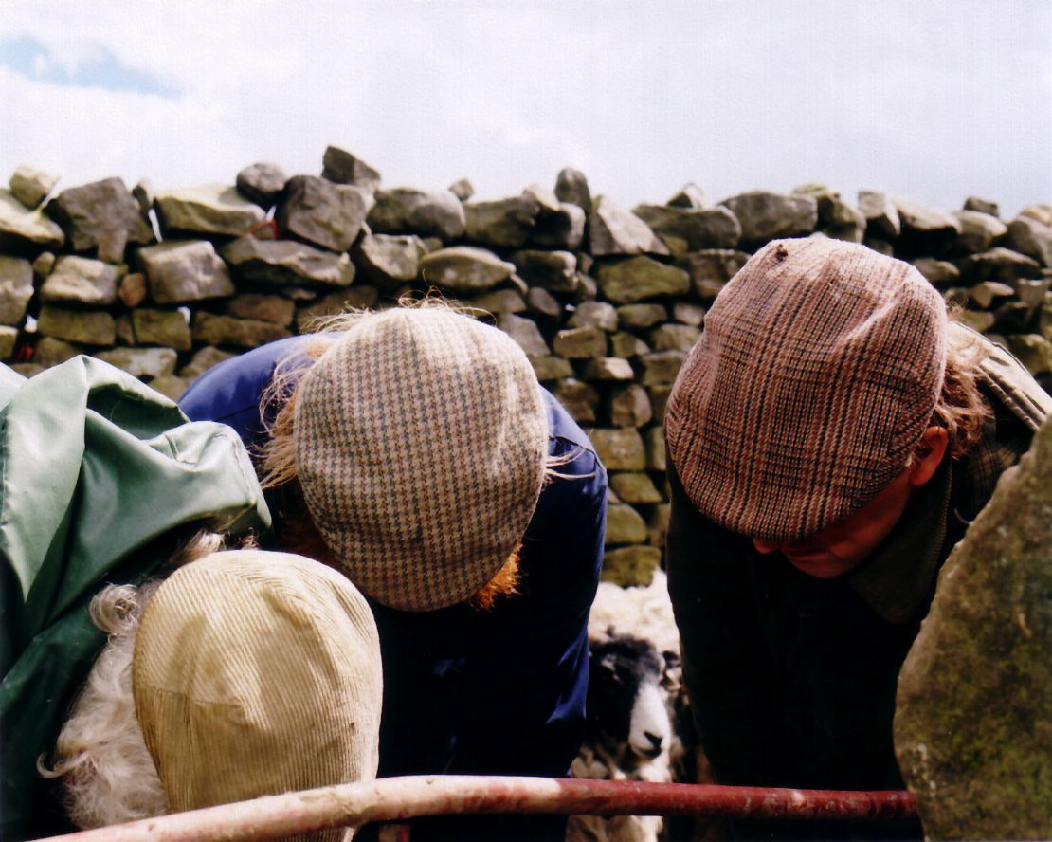
Unique!
One of the only projects nationally to provide this type of practical integrated business and environmental support that is farmer friendly
Good for YNYER LEP as one of the most rural LEPs to be taking this forward and leading the way linked to its SEP priorities

Slide 18
Disseminating the results
Full project report available shortly – executive summary available now!
Project partners will continue working with farmer clients to implement recommendations in the Plans as resources allow, but more support needed
We now need funding to support
implementation of both elements
‘How to’ information
available via
d.renwick@northyorkmoors.org.uk
paul.burgess@harrogate.gov.uk
Farmer Driven Network
Whole Farm Plans
Whole Farm Support
Farmer Support Clusters

Slide 19
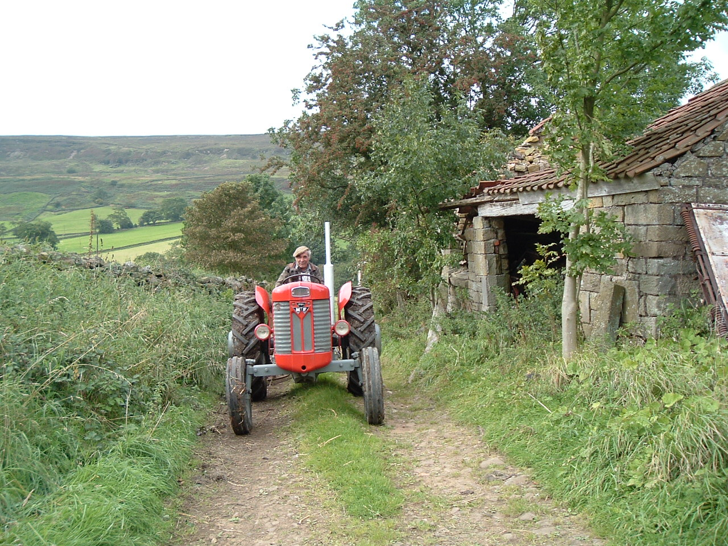
Thank you – Any Questions?

